Slide 1
Product gas properties, gas cleaning and applications
Technische Universität Wien
Institute of Chemical, Environmental and Bioscience Engineering
Research Unit of Fuel and Energy System Engineering
Research Group for Industrial Plant Engineering and Application of Digital Methods
DI Dr. Florian Benedikt
florian.benedikt@tuwien.ac.at

Slide 2



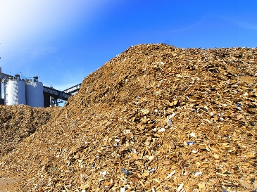
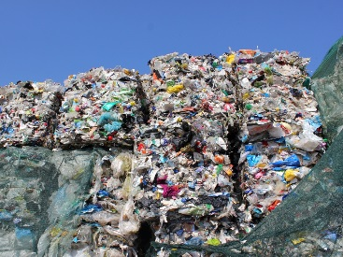

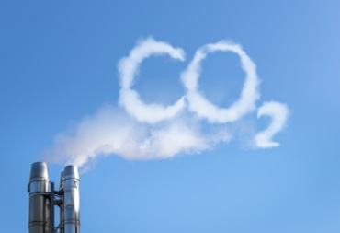


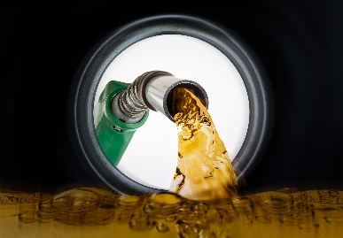
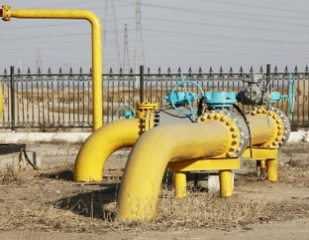
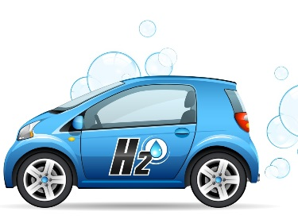

Vision of gasification technologies
conversion of biogenic raw and residual materials
resources
wood chips
residuals from agriculture
residuals from
industry
residuals from municipalities
sewage sludge/
manure
CO2 as feedstock
products
heat
electricity
advanced biofuels
synthetic natural gas (SNG)
hydrogen
platform chemicals
into clean energy carriers
2

Slide 3
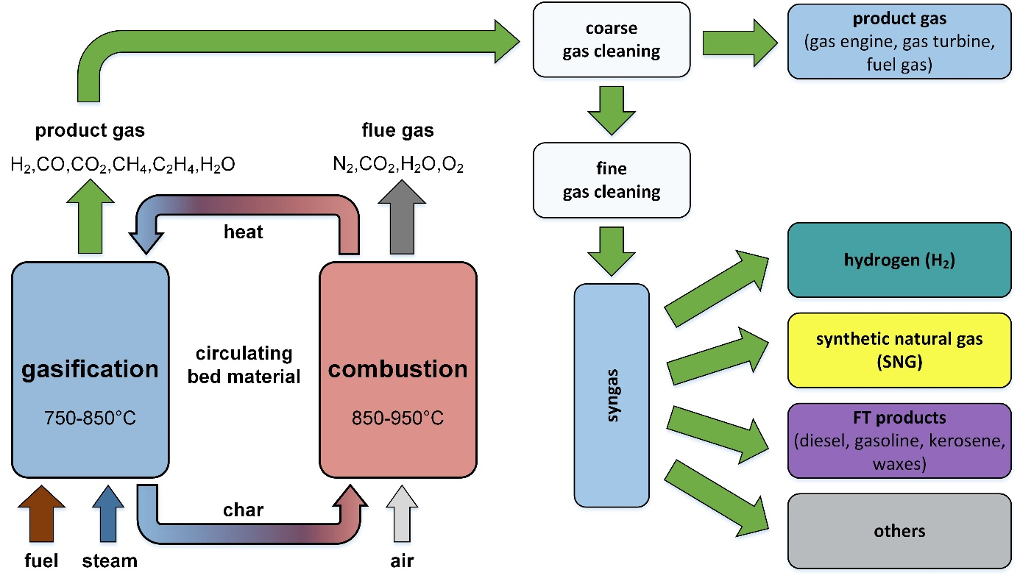
Dual fluidized bed (DFB) steam gasification:
Product gas cleaning and selected applications
3

Slide 4
Product gas properties: main gas composition
 | Unit | Air gasification | Steam gasification
Calorific value | MJ/m³ | 4 - 6 | 12 - 14
H₂ | vol.% | 11- 16 | 35 - 40
CO | vol.% | 13 - 18 | 25 - 30
CO₂ | vol.% | 12 - 16 | 20 - 25
CH₄ | vol.% | 3 - 6 | 9 -11
N₂ | vol.% | 45 - 60 | <1
Main gas composition
H₂
CO
CO₂
CH₄
N₂
H₂O
Resulting in:
H₂/CO – ratio:
important for synthesis applications
Heating value (CH₄ ~ 36 MJ/Nm³, CO ~ 12.6 MJ/Nm³, H₂ ~ 10.8 MJ/Nm³)
mainly depending on
gasification agent (H₂O, air, CO₂, …)
reactor type
operation parameters (temperature, pressure, bed material…)
feedstock

Slide 5
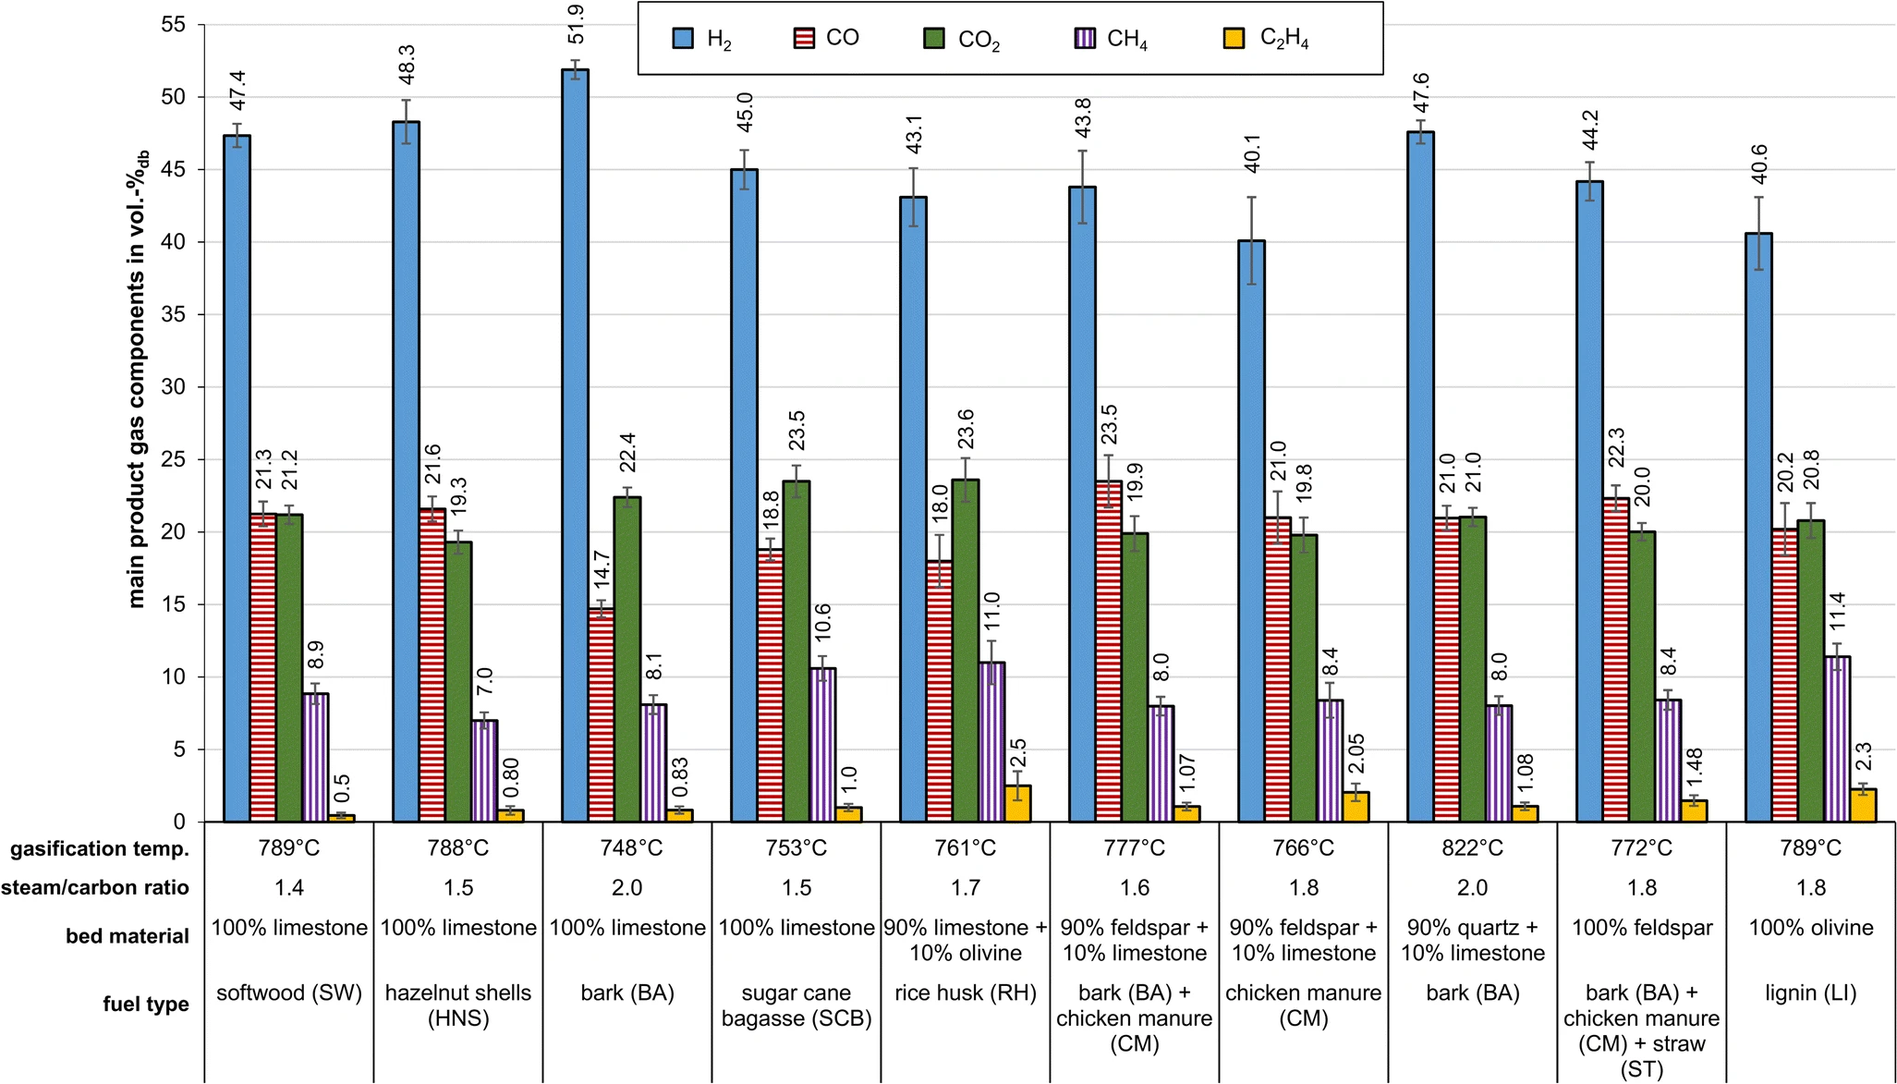
DFB steam gasification main product gas composition from biogenic feedstock
Schmid, J.C., Benedikt, F., Fuchs, J., Mauerhofer, A.M., Müller, S., Hofbauer H., 2019, "Syngas for biorefineries from thermochemical gasification of lignocellulosic fuels and residues - 5 years’ experience with an advanced dual fluidized bed gasifier design". Biomass Conversion and Biorefinery,

Slide 6
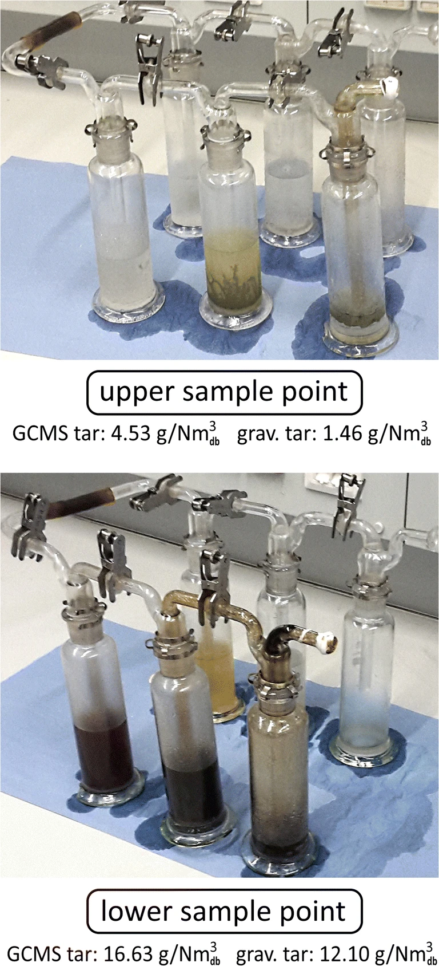
Product gas properties: impurities
Impurities
Particulate matter (fly dust/ash, fly char)
Tar “hydrocarbons with molecular weight higher than benzene”
Sulfur compounds (H₂S, COS, …)
Nitrogen compounds (NH₃, HCN, …)
Alkali compounds
Halides (HCl, …)
Resulting in:
Erosion, corrosion or deposits in downstream plant components
Gas cleaning due to compliance with emission limits or limits for downstream equipment (catalyst poisoning) or limits for end-users (grid feed-in, fuel cells, engines, …)
Schmid, J.C., Benedikt, F., Fuchs, J., Mauerhofer, A.M., Müller, S., Hofbauer H., 2019, "Syngas for biorefineries from thermochemical gasification of lignocellulosic fuels and residues - 5 years’ experience with an advanced dual fluidized bed gasifier design". Biomass Conversion and Biorefinery,

Slide 7
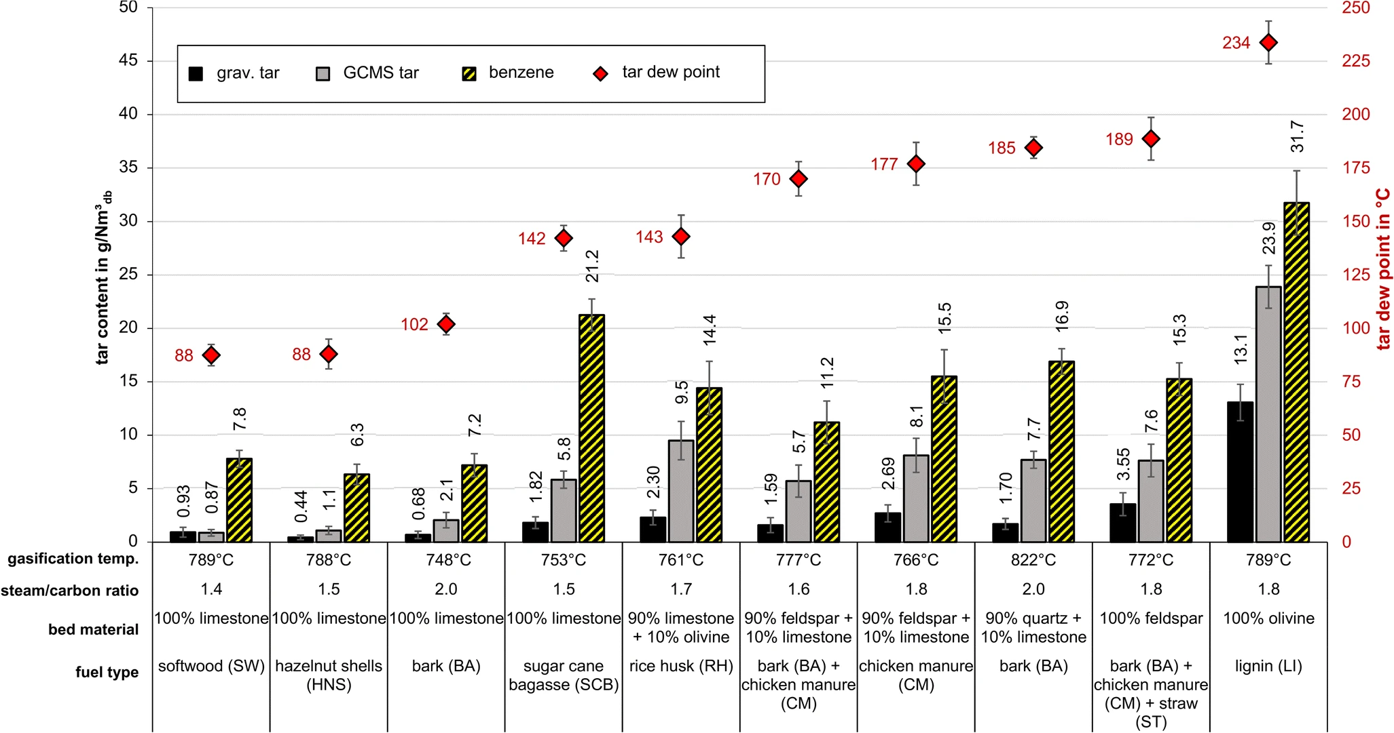
DFB steam gasification product gas impurities (tar) from biogenic feedstock
Schmid, J.C., Benedikt, F., Fuchs, J., Mauerhofer, A.M., Müller, S., Hofbauer H., 2019, "Syngas for biorefineries from thermochemical gasification of lignocellulosic fuels and residues - 5 years’ experience with an advanced dual fluidized bed gasifier design". Biomass Conversion and Biorefinery,

Slide 8
DFB steam gasification product gas impurities from biogenic feedstock
Parameter | Unit | SW | HNS | BA | SCB | RH | BA + CMª | CM | BA | BA + CM + ST^{b} | LI
Fly char | g/Nm³_{db} | 1–3 | 1–2 | 7–10* | 4–9 | 5–7* | 1.5–3 | 0.5–1 | 2–4 | 1–1.5 | 0.5–2
Dust | g/Nm³_{db} | 1–4 | 1–3 | 15–22* | 6–8 | 55–70* | 3–4 | 4–7 | 1–3 | 0.5–2 | 0.5–1
NH₃ | vol ppm | n.m. | n.m. | 3300** | n.m. | 7600 | 23,800 | 73,200 | n.m. | 23,900 | n.m.
H₂S | vol ppm | 17–23 | n.m. | 190–275 | n.m. | 460 | 360–480 | 340–390 | n.m. | 140 | n.m.
COS | vol ppm | 0.1–0.7 | n.m. | 0.3–0.7 | n.m. | n.m. | 13–16 | 25–61 | n.m. | n.m. | n.m.
HCl | vol ppm | n.m. | n.m. | 0.6** | n.m. | n.m. | n.m. | n.m. | n.m. | 14 | n.m.
HCN | vol ppm | n.m. | n.m. | n.m. | n.m. | n.m. | n.m. | n.m. | n.m. | 400 | n.m.
SW, softwood; HNS, hazelnut shells; BA, bark;
SCB, sugarcane bagasse; RH, rice husk;
CM, chicken manure; ST, straw; LI, lignin;
n.m., not measured
*High content because the cyclone downcomer clogged
**Value from a similar test run with bark
ª70% BA and 30% CM based on weight
^{b}60% BA and 25% CM and 15% ST based on weight
Schmid, J.C., Benedikt, F., Fuchs, J., Mauerhofer, A.M., Müller, S., Hofbauer H., 2019, "Syngas for biorefineries from thermochemical gasification of lignocellulosic fuels and residues - 5 years’ experience with an advanced dual fluidized bed gasifier design". Biomass Conversion and Biorefinery,

Slide 9
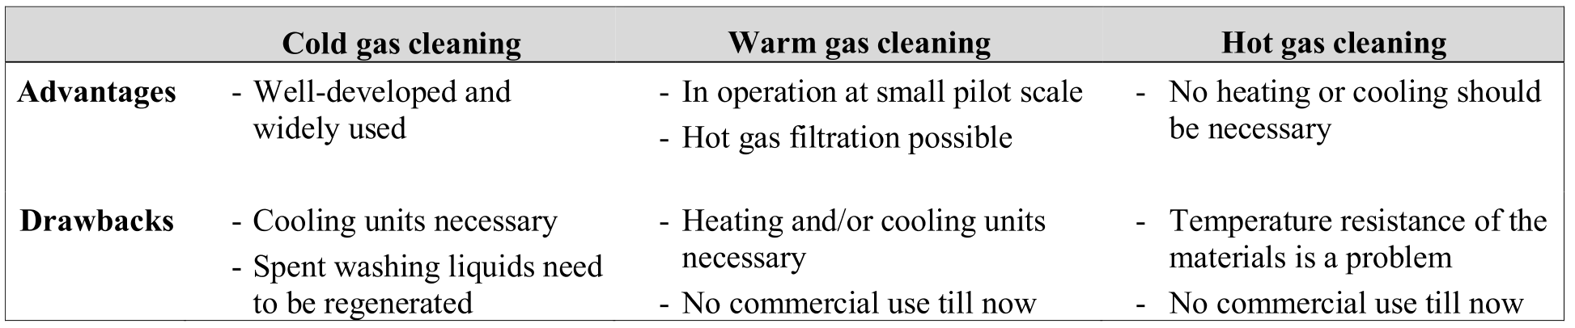
Product gas cleaning: classification according to temperature
T ≤ ambient temperature
100°C < T < 400°C
T > 400°C
Malicha, M., 2018, "Design of gas cleaning processes for SNGproduction from biogenic residues", Diplomarbeit, TU Wien, Oktober 2018
Woolcock, P. J., & Brown, R. C. (2013) “A review of cleaning technologies for biomass-derived syngas. Biomass and Bioenergy” , 52, 54–84.

Slide 10
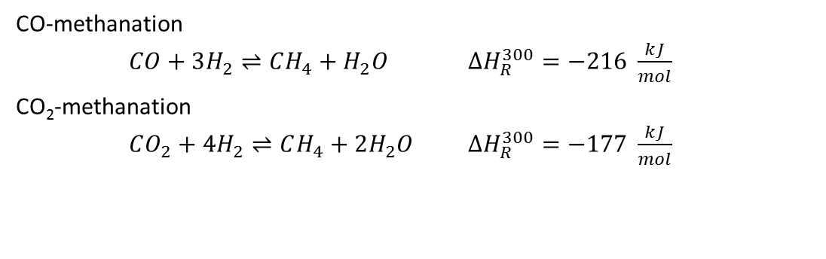
Operation conditions of hydrogen production, SNG and FT-synthesis
Product | Pressure | Temperature | Catalyst | H₂/CO | H₂/CO₂
Unit | bar | °C | - | mol/mol | mol/mol
Hydrogen | 1-30 | 200-1100 | Ni, Fe, Mo catalysts | -ª | -
SNG | 1-25 | 200-450 | Ni (mainly), Co, Fe, Ru catalysts | ≥ 3 | 4
FT products | 10-40 7-12 | 300-350 200-240 | Fe catalyst Co catalyst | 0.6–1.7; 2^{b} 2.0–2.15 | 1; 3^{b} 3
ª H₂O/CO ≥ 2 │ ^{b} Using potassium as promoter
CO-methanation
$CO+3H_{2}⇌CH_{4}+H_{2}O$ $ΔH_{R}^{300}=−216 \frac{kJ}{mol}$
CO₂-methanation
$CO_{2}+4H_{2}⇌CH_{4}+2H_{2}O$ $ΔH_{R}^{300}=−177 \frac{kJ}{mol}$
Molino A, Larocca V, Chianese S, Musmarra D. “Biofuels Production by Biomass Gasification: A Review”, Energies 2018;11(4):811.

Slide 11
Limits of product gas impurities for selected applications
Contaminant | Unit | Syngas applications |  |  |  |  | Gas turbine | Gas engine
 |  | MeOH | EtOH | FT | H₂ | SNG
Particulate matter | mg/Nm³ | <0.02 | 0 | 0 | 0 | 0 | <20-30 | <50
Tar | mg/Nm³ | <0.01 | <0.5ª | <0.1 -1 | <1-2 | <5 | <5-10 | <100
Alkali compounds | ppm_{v} | <0.005 | n.a. | <0.01 | n.a. | n.a. | <0.02 -0.05 | <0.1^{b}
N-contaminants | ppm_{v} | <0.1-10 | <1-10 | <0.02 -10 | <1-10 | <30 | <50 | n.a.
S-contaminants | ppm_{v} | <0.5 | <1-50 | <0.01 | <1-50 | <0.1^{c} | <1-20 | <20
Halides | ppm_{v} | <0.001 | n.a. | <0.01 | n.a. | <10 | <0.5-1 | n.a.
n.a. = not available │ ª in ppmv │ ^{b} in mg/Nm³ | ^{c} for Ni-catalysts
Molino A, Larocca V, Chianese S, Musmarra D. “Biofuels Production by Biomass Gasification: A Review”, Energies 2018;11(4):811.
Veress M. “Optimization of a process concept for the industrial production of Bio-SNG from low-grade fuels”, master thesis, Vienna, TU Wien, 2020.

Slide 12
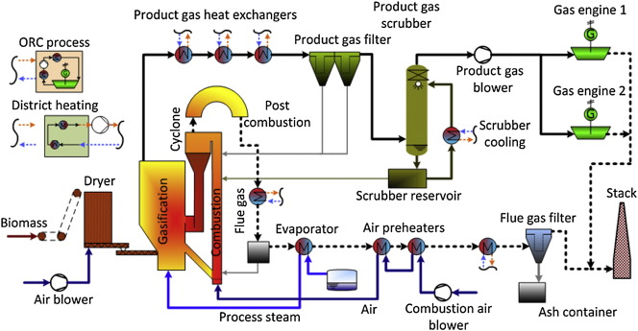
Product gas cleaning DFB steam gasification for gas engine application
~150°C
800-850°C
~40°C
removes particles, alkalines, tar
removes tar, water, HCl, NH₃

Slide 13


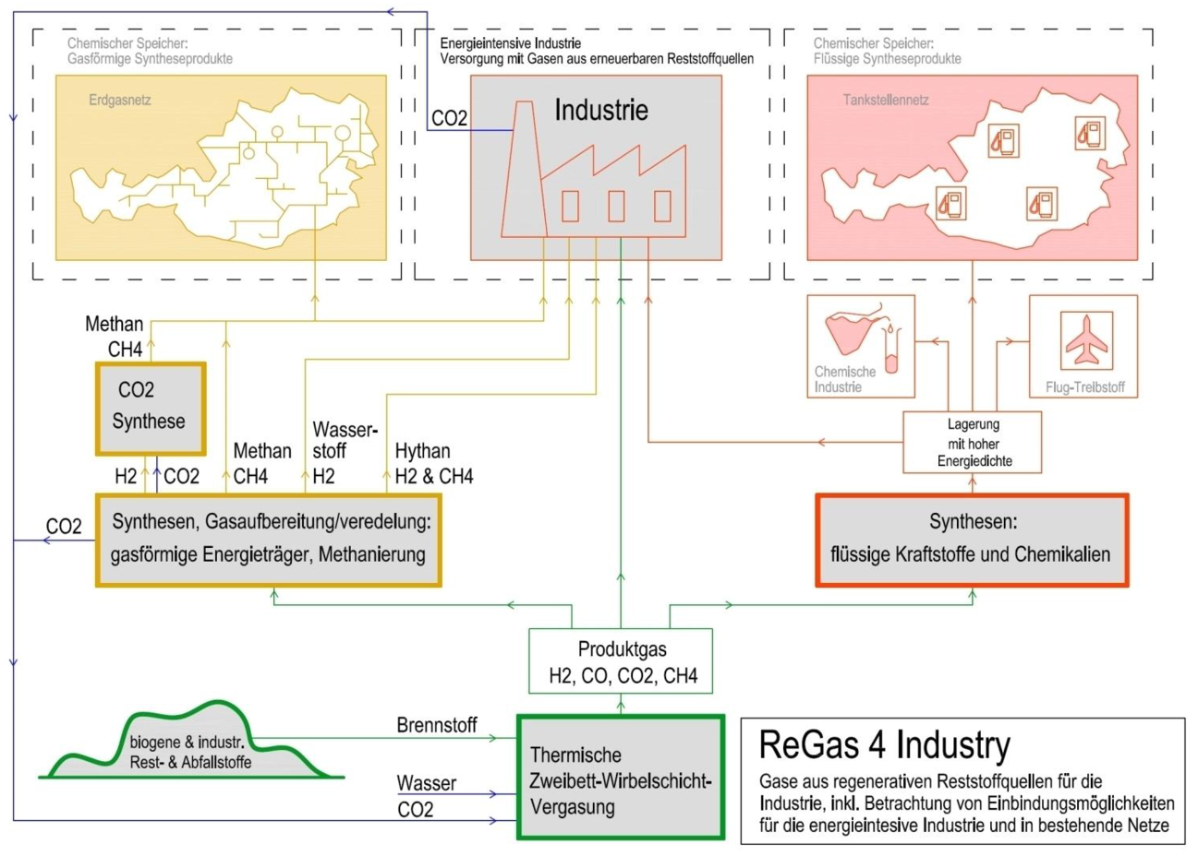
Project „ReGas4Industry“
Efficient and cost-effective conversion of biogenic residues to synthetic natural gas (SNG) via gasification and catalytic methanation.
Targets:
Utilization of biogenic residues for SNG production
Novel reactor/process concepts for a simplified and efficient conversion
Fundamental knowledge to support scale-up
Cost reduction
Duration: 04/2019 – 09/2021
Status: Ongoing
13

Slide 14
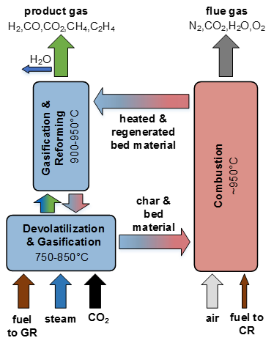
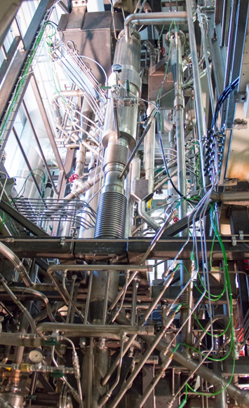
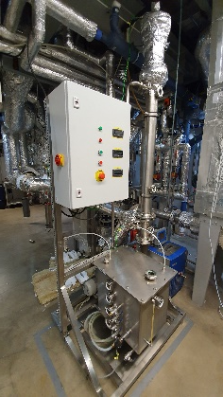
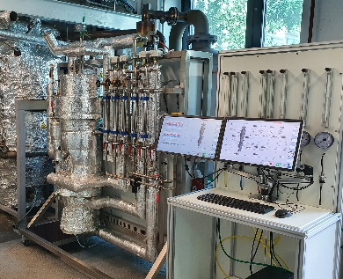
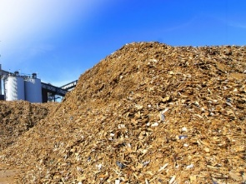
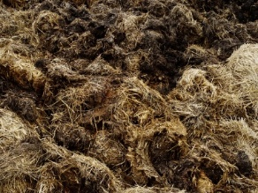
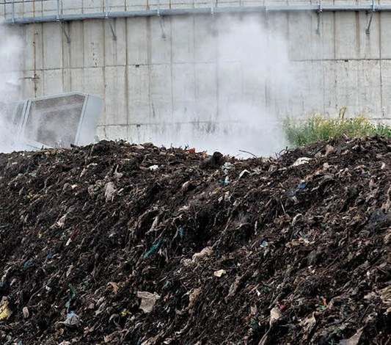


„ReGas4Industry“ experimental approach at TU Wien
DFB steam/CO₂ gasification
gas cleaning
Technoeconimic and ecological assessment
sewage sludge
SNG from biogenic residues
alternative fuels
digestate
bark
methanation
reject
SNG
14

Slide 15
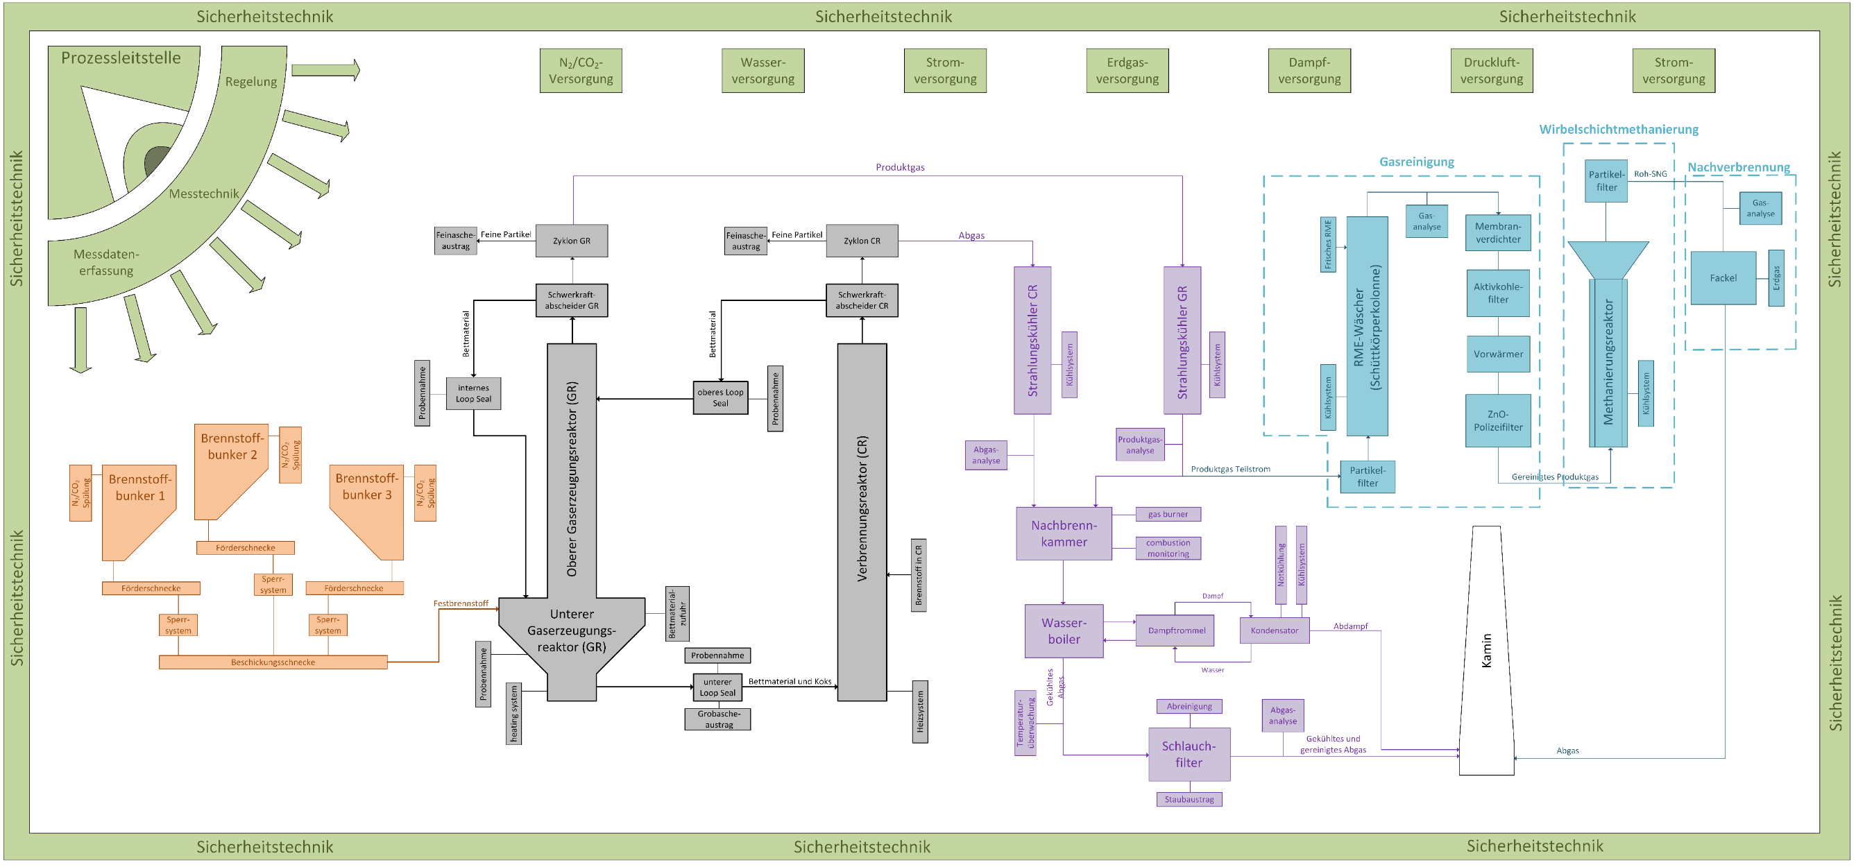
„ReGas4Industry“ basic flow sheet
Biodiesel scrubber
Activated carbon filter
ZnO guard filter
Fluidized bed methanation
15
100 kW DFB Gasification
10 kW SNG process chain

Slide 16

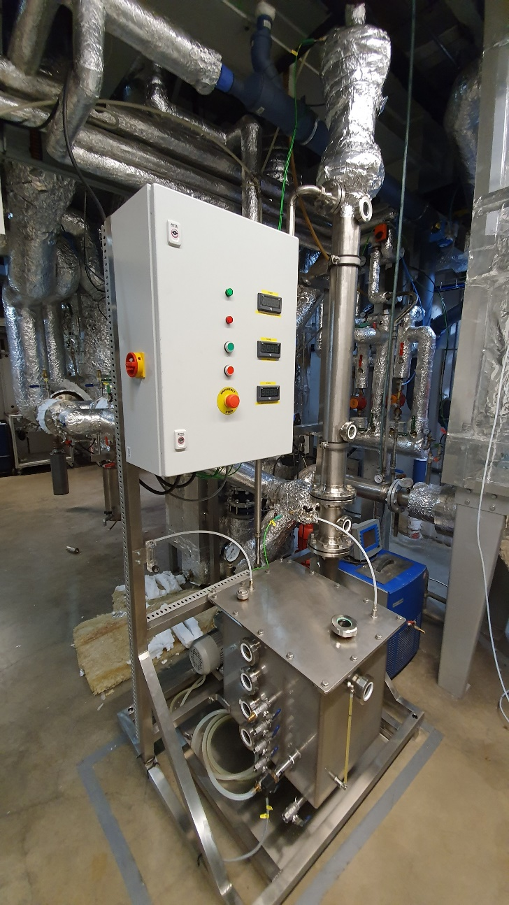
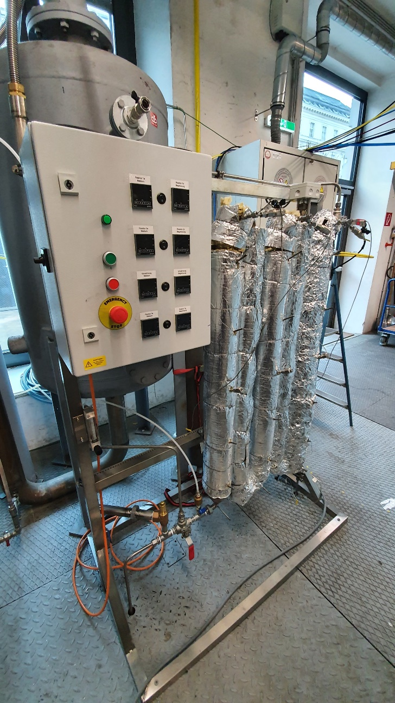
DFB Gasifier, biodiesel scrubber and adsorption unit
16

Slide 17
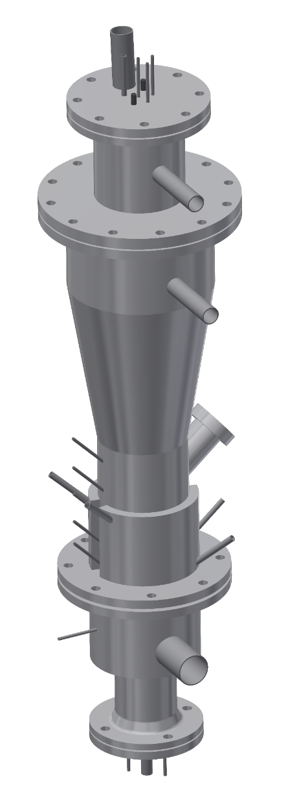
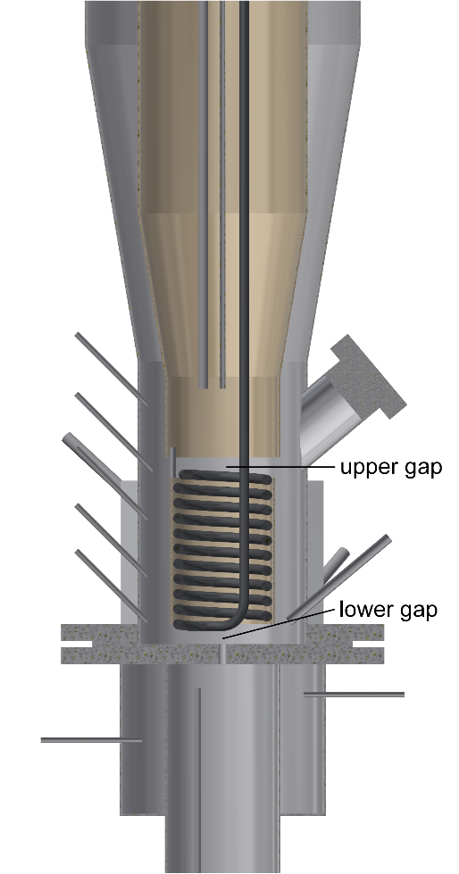
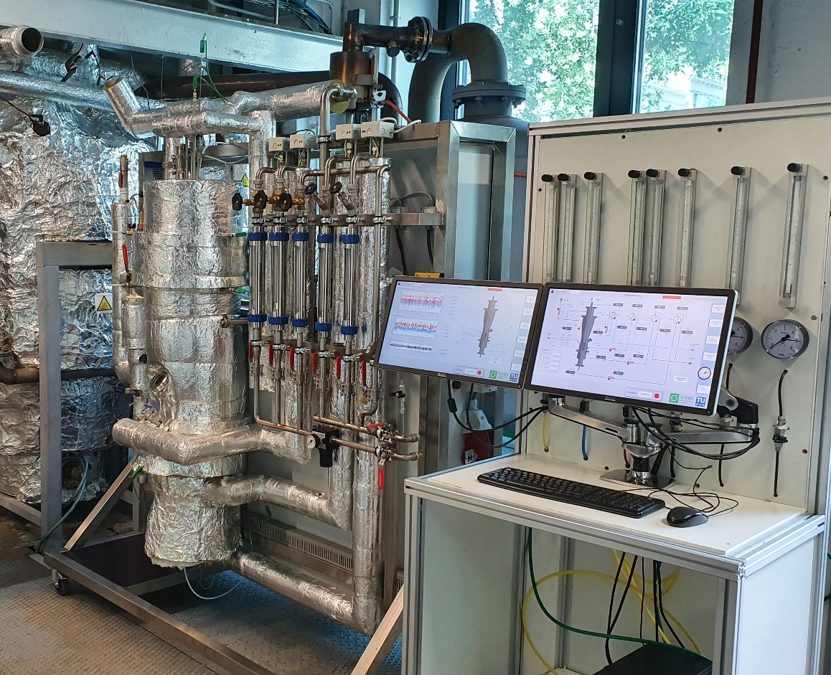
Fluidized bed methanation
17

Slide 18
Vision of gasification technologies
conversion of biogenic raw and residual materials
resources
wood chips
residuals from agriculture
residuals from
industry
residuals from municipalities
sewage sludge/
manure
CO2 as feedstock
products
heat
electricity
advanced biofuels
synthetic natural gas (SNG)
hydrogen
platform chemicals
into clean energy carriers
18

Slide 19
Product gas properties, gas cleaning and applications
Technische Universität Wien
Institute of Chemical, Environmental and Bioscience Engineering
Research Unit of Fuel and Energy System Engineering
Research Group for Industrial Plant Engineering and Application of Digital Methods
DI Dr. Florian Benedikt
florian.benedikt@tuwien.ac.at

