Slide 1


Gasification of wooden biomass: Possible feedstock and their properties
DiBiCoo, 05th August 2021

Slide 2
Role of biomass within renewables
Renewables contributed to the World energy demand 2018 by around 13.5 %
  Thereof biomass reached 68 %
It is very versatile
  Direct combustion
    Heating
    Lighting
    Transport
    Electricity & heat
  Gasification
    Electricity & heat
    Biomethane
Saisonally storable

Slide 3
Differences between application techniques depending on the occurrence of oxygen

Slide 4
Important properties:
Main ingredients of different types of biomass

Slide 5
Important properties:
Main ingredients of different types of biomass

Slide 6
Important properties:
Main ingredients of different types of biomass

Slide 7
Important properties:
Ash melting point
Calcium contributes to a higher ash melting point
Potassium and magnesia causes a lower melting point
Straw has a significant lower hemisphere temperature and additionally for the flow temperature
Much more for cereals

Slide 8
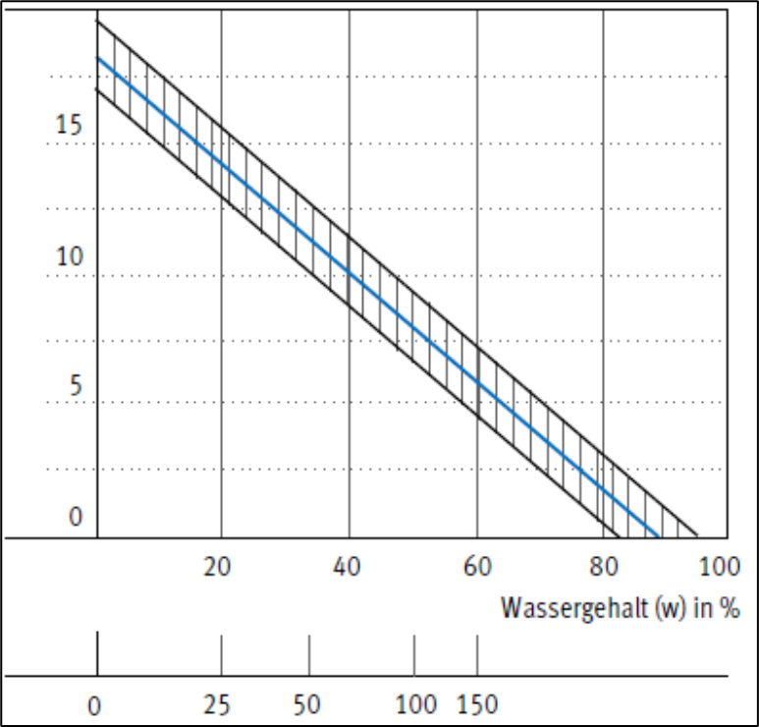

Important properties:
Heating value depending on water content
  If not declared most times water content is used
  A high water content causes, besides the loss of heating value, unwanted wet gasifier gas
  Energy demand for heating up water: 0.004 MJ kg_{H2O}⁻¹ °C⁻¹
  Energy demand for vaporization: 2.26 MJ kg_{H2O}⁻¹

Slide 9
Important properties:
Net and gross calorific value depending on type of feedstock
Most difference comes from density and additionally from resin within conifers

Slide 10

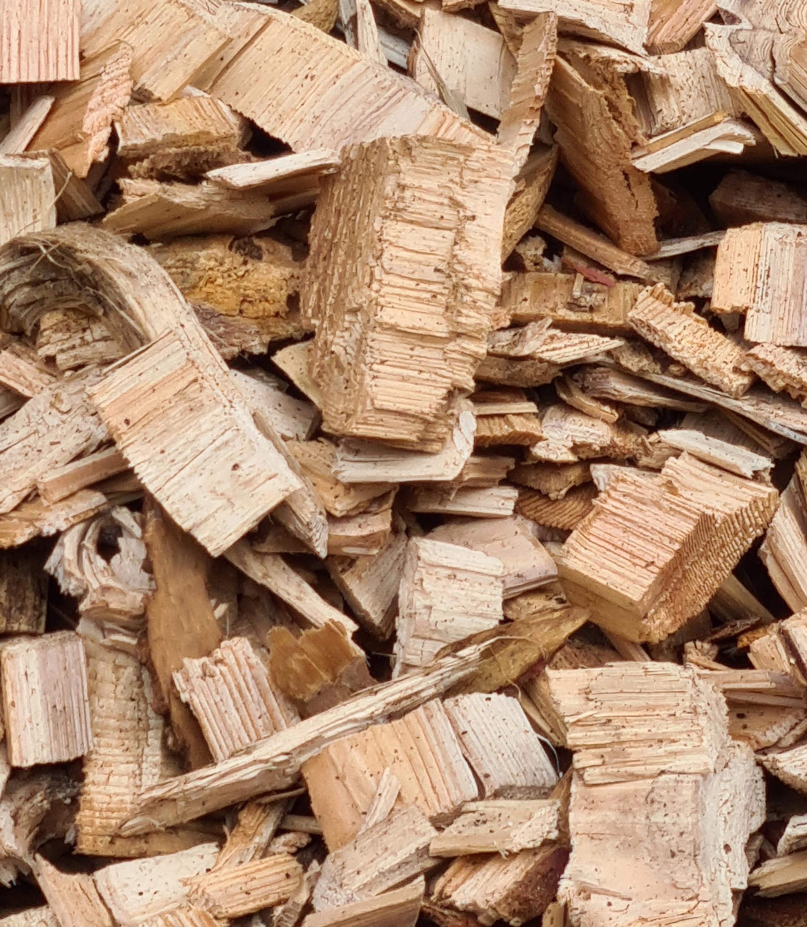
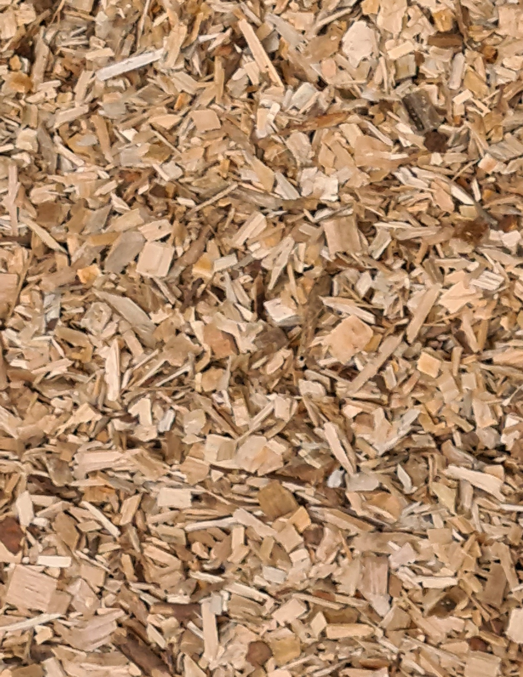
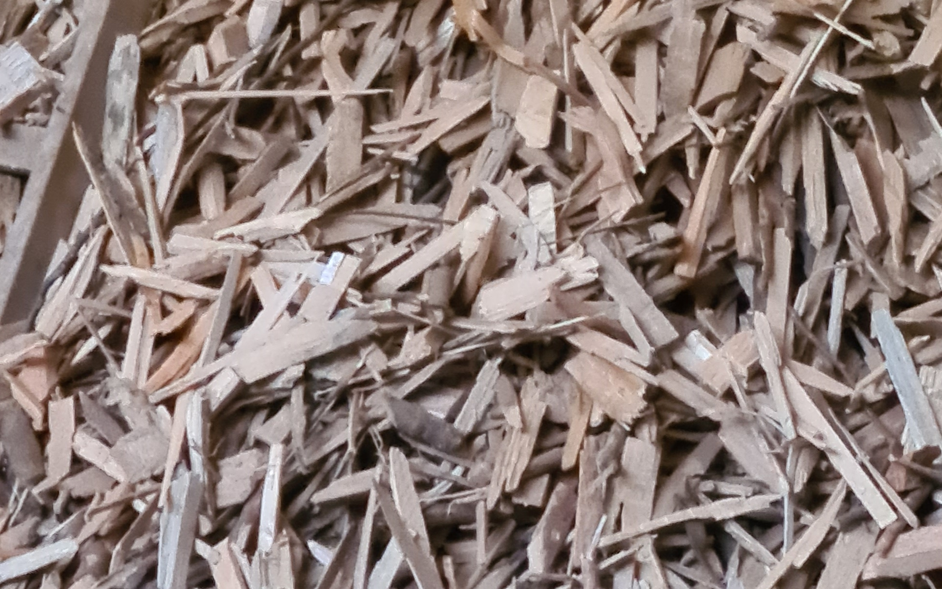
Wood chips from different types of chipper
Wood chips from Drum chipper
Wood chips from Screw chipper
Sieved fine dust
Oversized chips

Slide 11
Thanks for your attention
DiBiCoo, 05th August 2021

Slide 12
Exotherm vs Endotherm

Slide 13

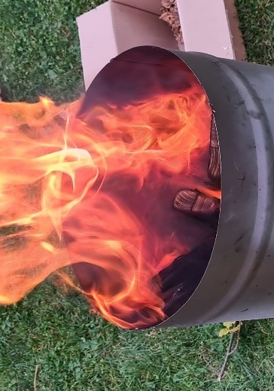
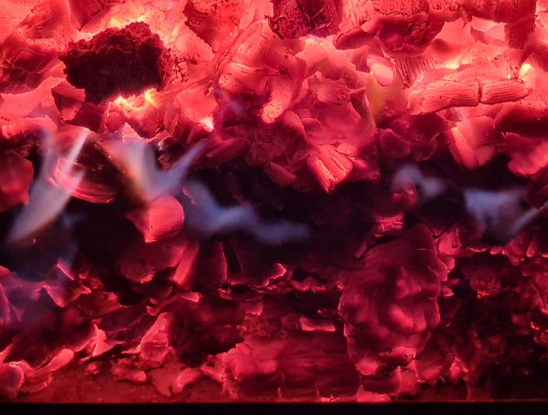
Temperature dependant steps of conversion

Slide 14
Different pathways to convert the energy within biomass

Slide 15
Different pathways to convert the energy within biomass

Slide 16
Different pathways to convert the energy within biomass

Slide 17
Differentiation of different types of gasification technologies

