Slide 1
Security measures, legislation and experience in Argentina
Dibicoo survey 2/2021

Slide 2
Main findings
Most big plants comply with EU standards
100 % perception that national standards are insufficient
Most accidents are in construction and gas operation
Plant audits and capacity building were mention as improvement measures
Standards used IEC AEA NFPA CATEX OSHA 18001 ISO 9001 & 13.000 NAG

Slide 3
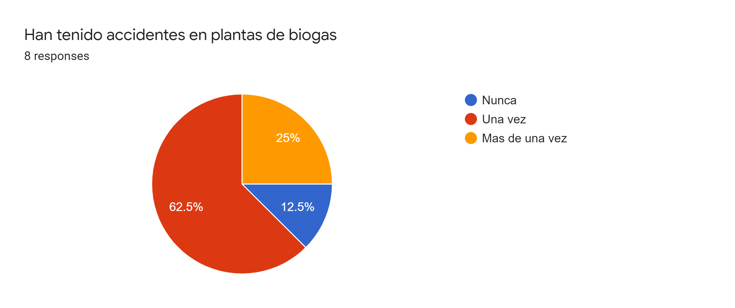
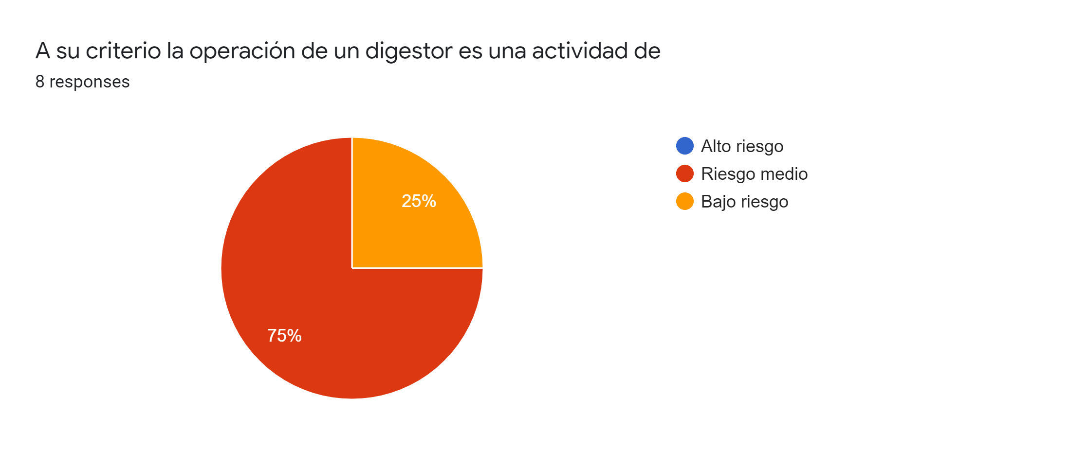
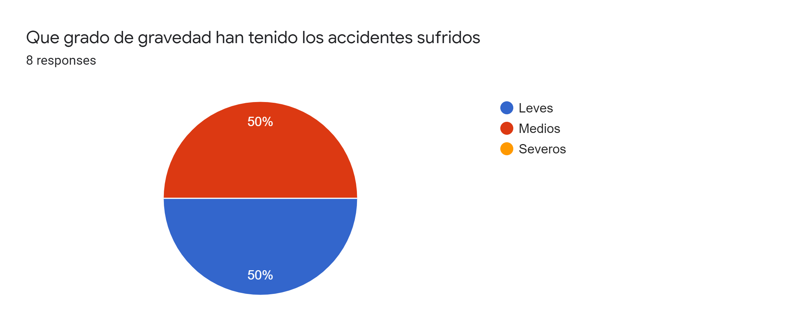
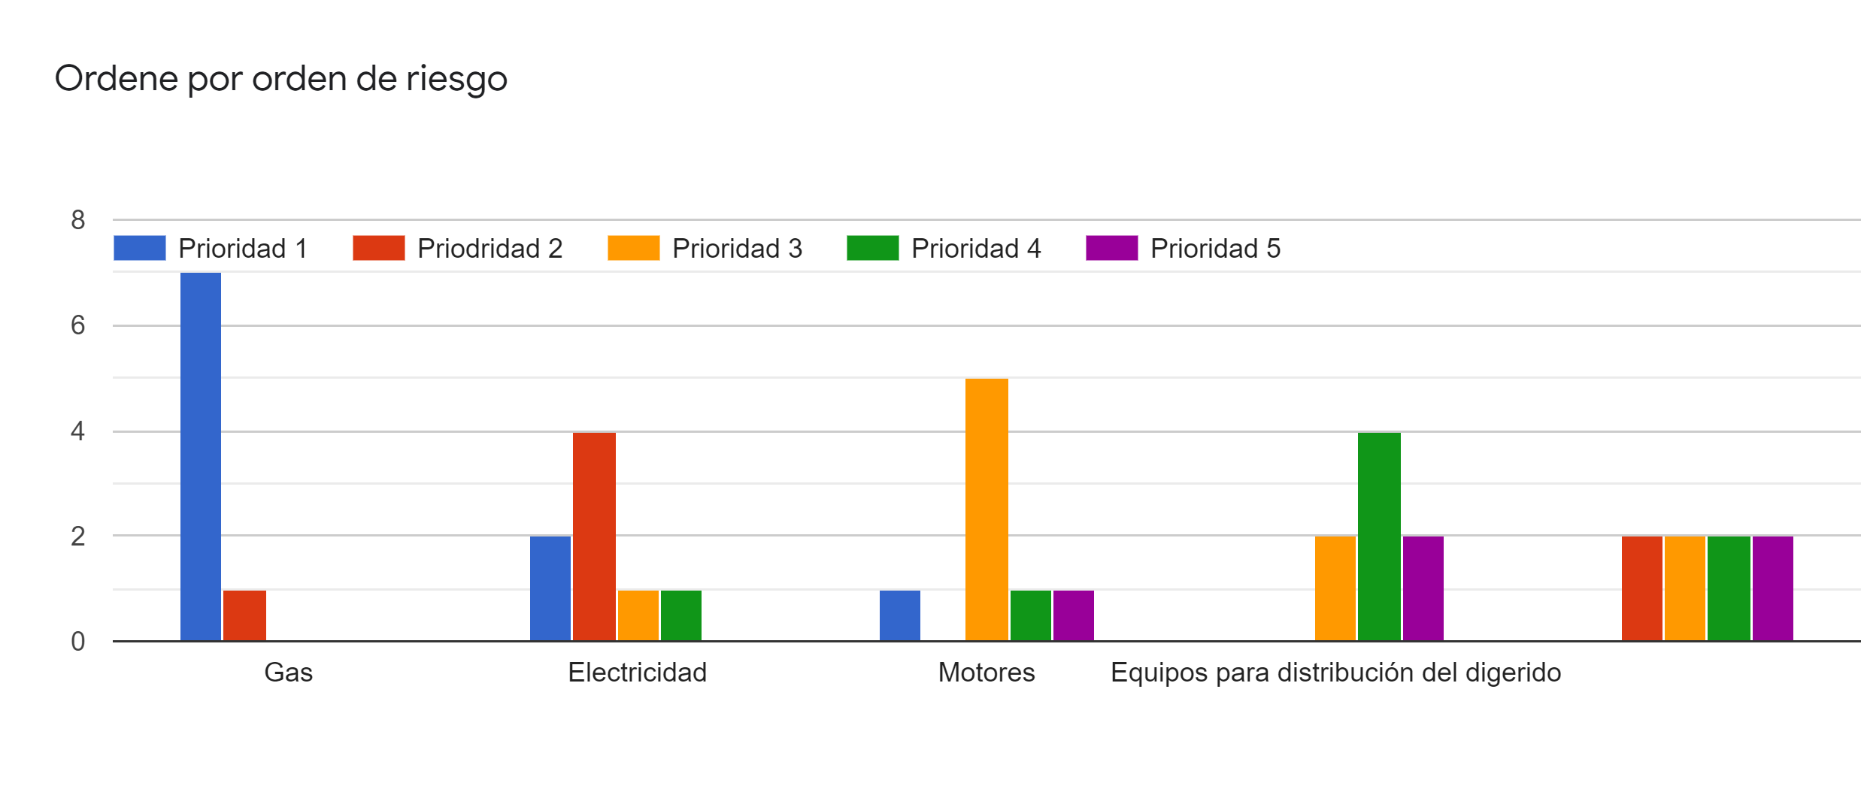
Main results

